Slide 1


Advanced Database Management Systems
Lecture 4

Slide 2
SQL CLAUSES
Join Vs Subquery
Nested Queries

Slide 3
Nested Queries
A subquery or Inner query or a Nested query is a query within another sql query.
It involves two select statements.
Syntax:
SELECT column(s)
FROM table_name
WHERE col_name operator
(subquery);
Notes:
Three methods of writing this, 1: using select, 2: using FROM, 3: Where clause (mostly used)

Slide 4
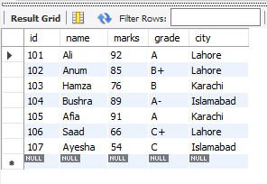
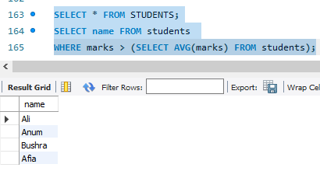
Nested Queries - Example 1
Get names of all students who scored more than class average.
Steps:
Step 1: Find the avg of class
Step 2: Find the names of students having marks > avg
Table Output:

Slide 5
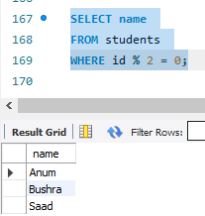
Nested Queries - Example 2
Find the names of all students with even roll numbers.
Steps:
Step 1: Find the even roll numbers
Step 2: Find the names of students with even roll no
Table: Output:

Slide 6
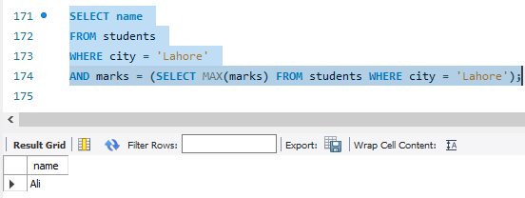
Nested Queries - Example 3
Find the name of the student from Lahore who scored the highest marks among all students from the same city.
Table: Output:

Slide 7
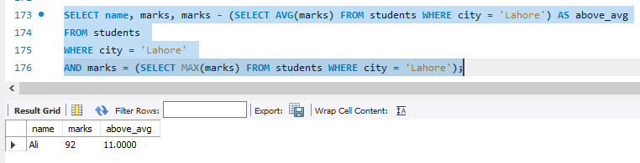
Nested Queries - Example 4 with Select
Find the student from Lahore who scored the highest marks among all students from Lahore, and also find how much they scored above the average marks of all Lahore students.

Slide 8
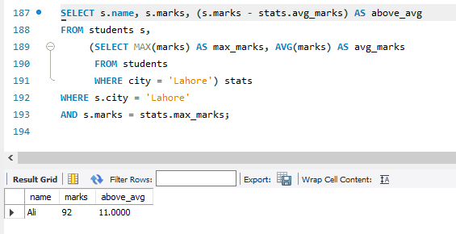

Slide 9
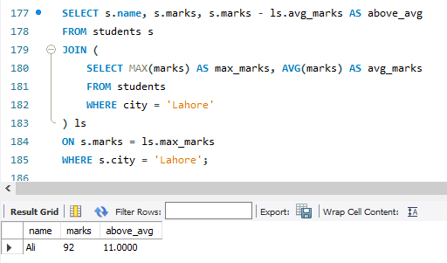

Slide 10
Exist Operator
The EXISTS operator is used to test for the existence of any record in a subquery.
The EXISTS operator returns TRUE if the subquery returns one or more records.
Syntax:
SELECT column_name(s) FROM table_name WHERE EXISTS (SELECT column_name FROM table_name WHERE condition);

Slide 11
IS NULL
The IS NULL operator is used to test for empty values (NULL values).
Syntax:
SELECT column_names FROM table_name WHERE column_name IS NULL;
Example:
The following SQL lists all customers with a NULL value in the "Address" field:
SELECT CustomerName, ContactName, Address FROM Customers WHERE Address IS NULL;

Slide 12
IS NOT NULL
The IS NOT NULL operator is used to test for non-empty values (NOT NULL values).
Syntax:
SELECT column_names FROM table_name WHERE column_name IS NOT NULL;
Example:
The following SQL lists all customers with a value in the "Address" field:
SELECT CustomerName, ContactName, Address FROM Customers WHERE Address IS NOT NULL;

Slide 13
Class Task for Today
Download and open ’’Lab manual 4” from Google classroom and start solving it.

Slide 14
End of Lecture

